Slide 1
Smart Alarm Clock
Vlad Lupita
Raul Nicu
Mohamed Sobhi

Slide 2
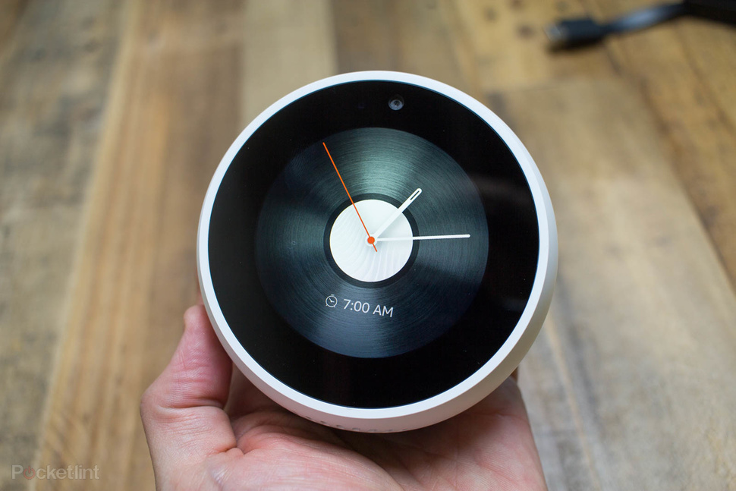
Why Smart Alarm Clock?
A Smart Alarm makes your life easier .
Allows the user to set up the alarm from the phone.
Reminds you to set alarms on working days .

Slide 3
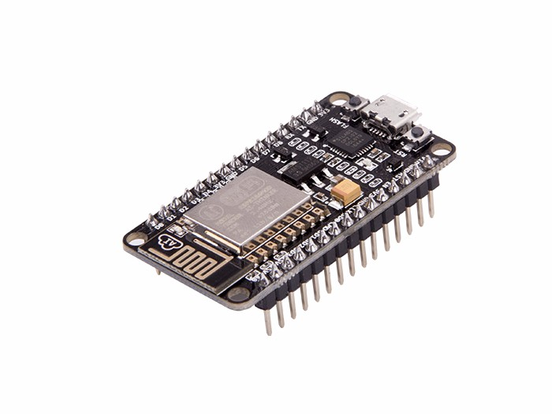
System components
2 NodeMCUs (1 is connected to the Temperature Sensor , the other one is connected to the Light Sensor). Data is collected and sent to Firebase.

Slide 4
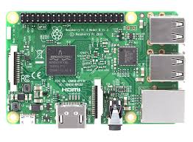
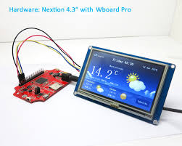
Raspberry PI collects information from Firebase ,process data and displays the corresponding date, time ,temperature and light on the Nextion screen.

Slide 5
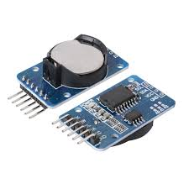
-One clock sensor is connected to Raspberry sending information about date and time.
Smart alarm clock comes with an Android Application that facilitates users to set an alarm from their Smart phones.

Slide 6
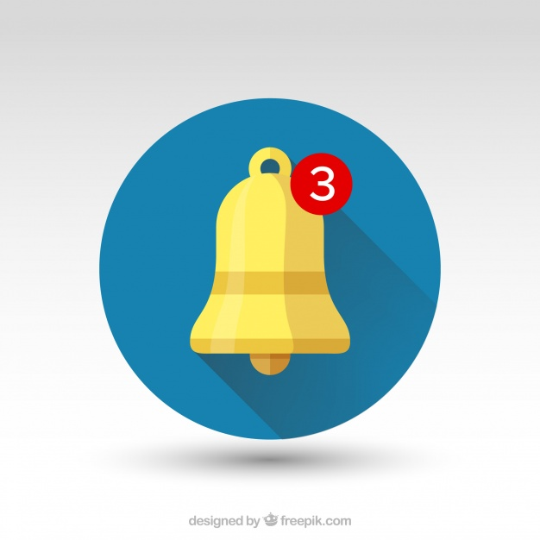
-System sends push notifications to the user via an application called ''Pushover'‘

Slide 7
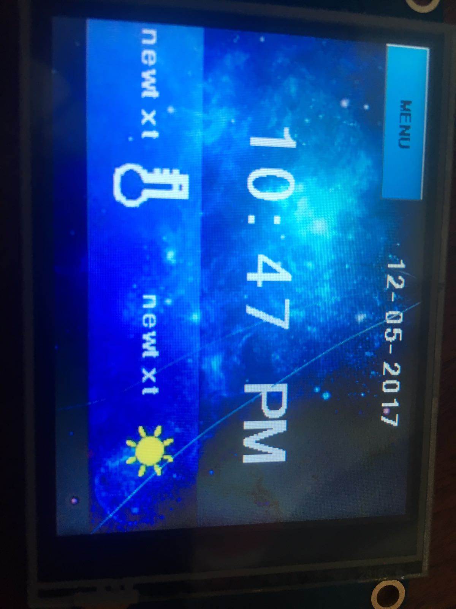
Here’s a Picture of the LCD screen

Slide 8
Made BY :
MOHAMED SOBHI
LUPITA VLAD
NICU RAUL
THANK YOU

